Slide 1
Setting up a Frontend Web Development Environment
IT 3203
Fall 2026
Dr. Jack Zheng

Slide 2
Overview
This tutorial will help you set up your own web development environment and begin the fun of web development (for all exercises and projects in this class).
All information is valid for the semester indicated in the title slide. Things may change in the future and please use it just as a reference.
Please complete this within the first two weeks of the semester!

Slide 3
Development Environment Summary
GitHub Pages https://pages.github.com
Web hosting (public web server) that hosts your GitHub website (free)
Visual Studio Code https://code.visualstudio.com
Code editor / IDE (integrate development environment)
Git is also integrated in VS Code.
CodePen https://codepen.io
Online coding playground for quick testing!
GitHub Desktop https://github.com/apps/desktop
The GUI tool to manage source code and code publication
All are free!

Slide 4
GitHub Pages https://pages.github.com
GitHub pages serves websites directly from GitHub repositories
Need a GitHub account
The course website is hosted by GitHub Pages https://ksuweb.github.io/IT3203/
Features
Provides free services for Git based projects.
Only hosts client-based web sites/apps (HTML/CSS/JavaScript)
Good for frontend development
How to set up a root level GitHub website?
https://www.khanacademy.org/computing/computer-programming/html-css/web-development-tools/a/hosting-your-website-on-github
Also follow https://pages.github.com for quick setup for a project site (subsite in a subdirectory)
The guide to set up a website is right on this page. Please follow the steps:
First choose “project site” and then “Start from scratch”
Just follow the rest of the steps

Slide 5
Manage repositories and source codes updates
Use the built-in upload tools on the GitHub website
see the Khan Academy tutorial in previous slide
Use VS Code integrated GitHub extension – recommended
See next slide
Note in this class, we use GitHub extension more like a file publishing tool, rather than as source and version control tool.

Slide 6
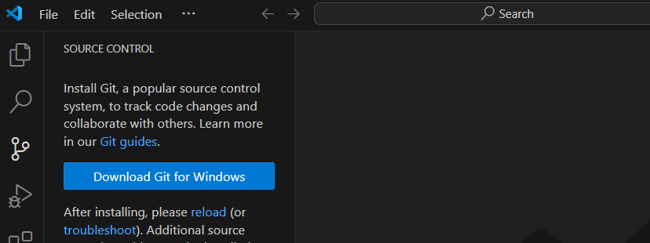
Use Git Directly in VS Code
Download and install Git system. See a quick setup
https://www.youtube.com/shorts/r-C7s15IvDM
For more info, visit
https://code.visualstudio.com/docs/sourcecontrol/overview
https://code.visualstudio.com/docs/sourcecontrol/intro-to-git

Slide 7
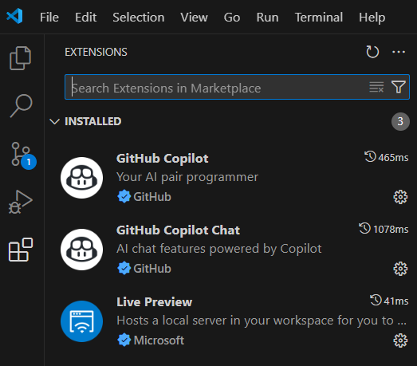
Useful VS Code Extensions
Recommended
Live Preview
GitHub Copilot
GitHub Copilot Chat
Go to Extensions and look for these to install

Slide 8
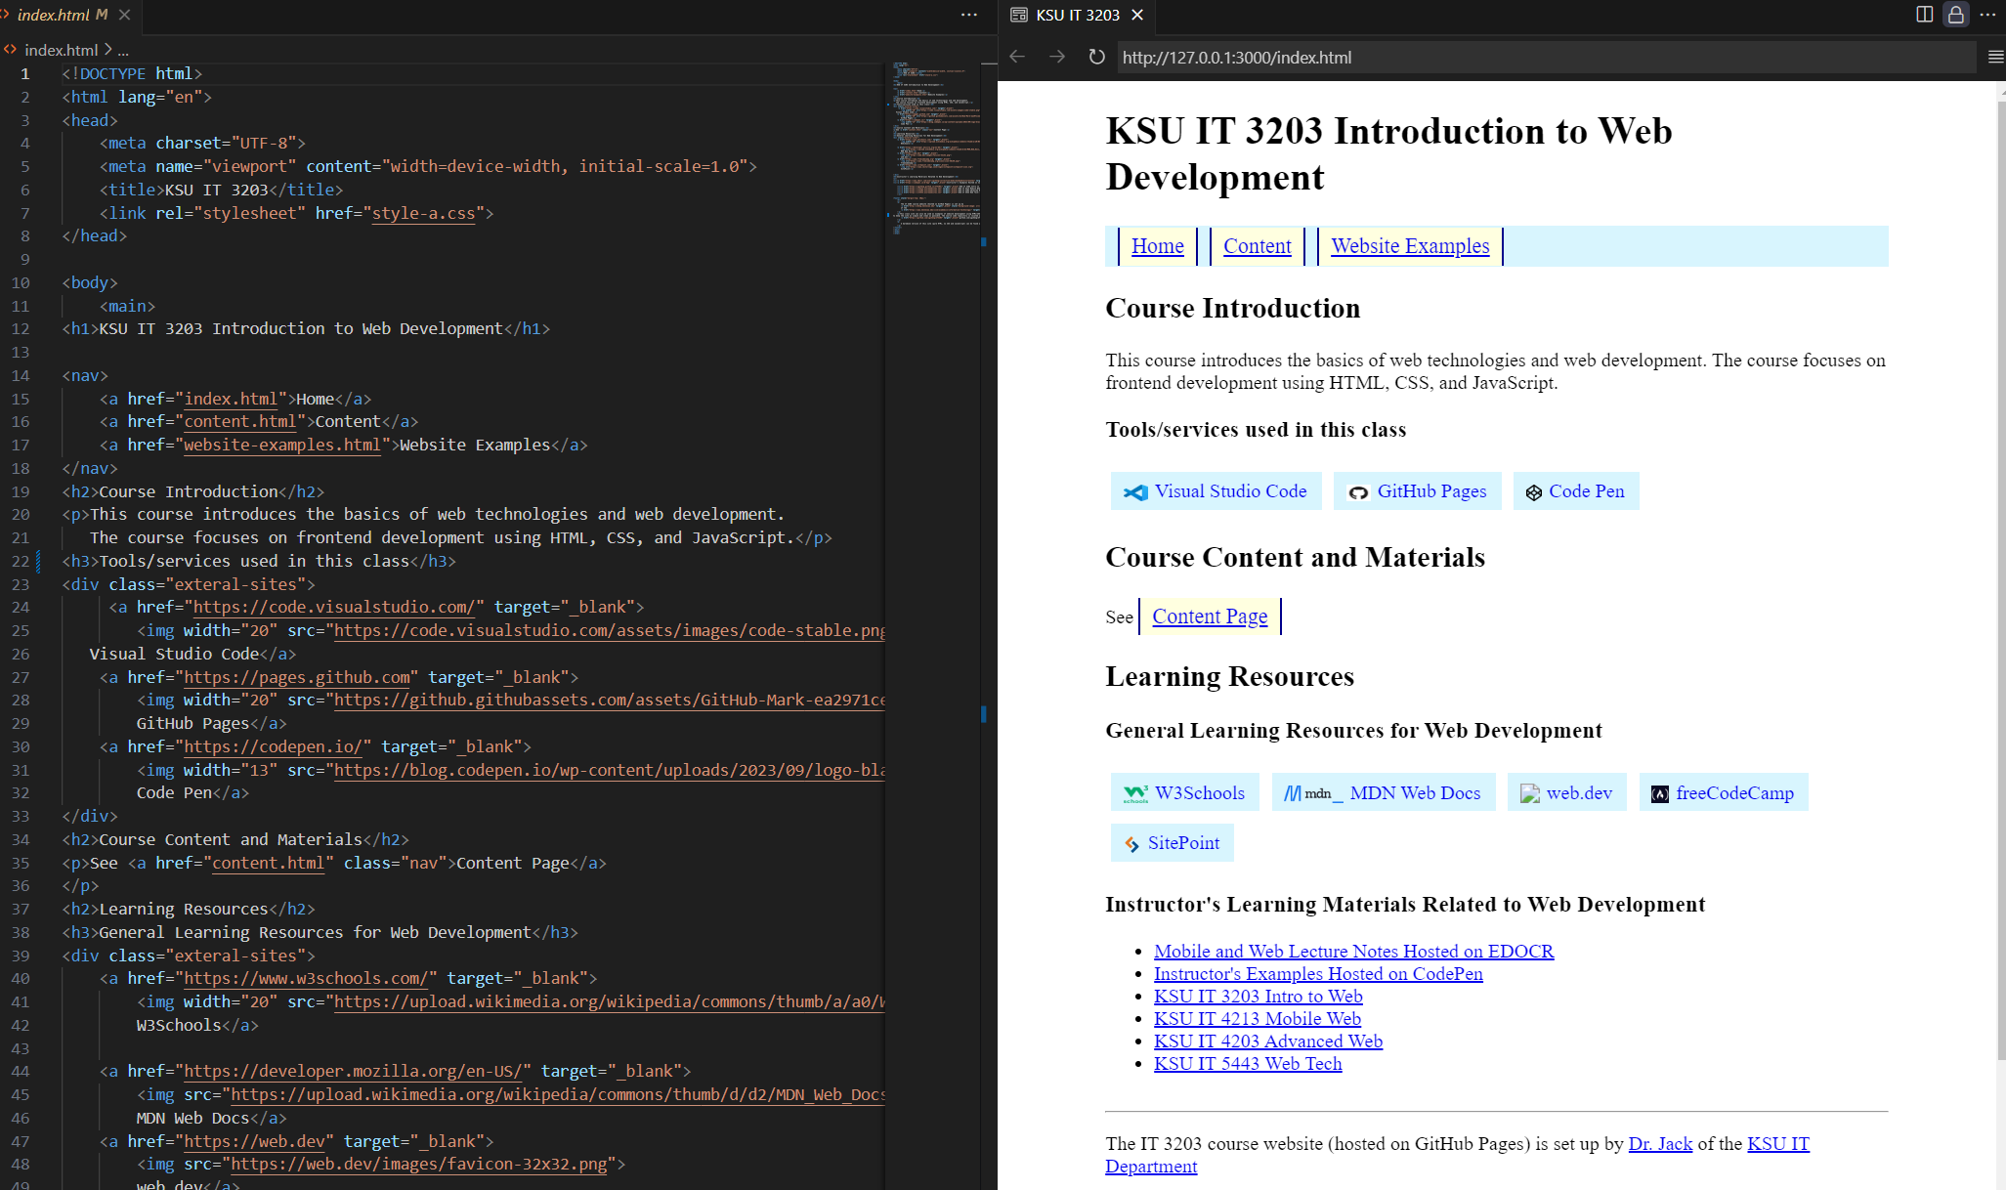
Live Preview
Live preview allows instant preview while editing

Slide 9
Tool Alternatives (for reference only)
Code editor or IDE (integrate development environment)
Notepad ++ https://notepad-plus-plus.org
Honorable mention: http://brackets.io
GitHub Desktop to Manage GitHub Repositories
[Video] Git, GitHub, & GitHub Desktop for beginners https://www.youtube.com/watch?v=8Dd7KRpKeaE
How to Use GitHub Desktop: A GitHub Desktop Tutorial https://www.simplilearn.com/how-to-use-github-desktop-tutorial-article
WinSCP https://winscp.net
You may use other tools if you are familiar with them.
All are free!

Slide 10
Other Free Web Hosting that supports server-side development (for reference only)
Microsoft Azure
https://azureforeducation.microsoft.com/en-us/Institutions
More advanced features and more server-side support
Good for advanced web development class
Sample Azure hosted sites for other web classes
https://it4203.azurewebsites.net
https://it4213.azurewebsites.net
https://it5443.azurewebsites.net
Others
https://render.com – also uses GitHub for repositories
https://glitch.com – using online code editor

